Slide 1
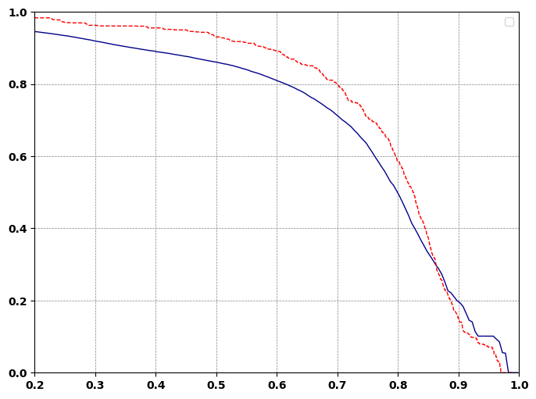
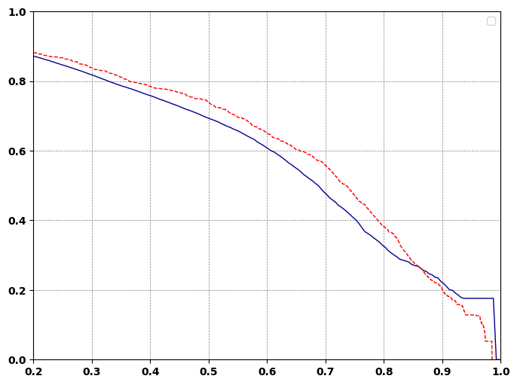
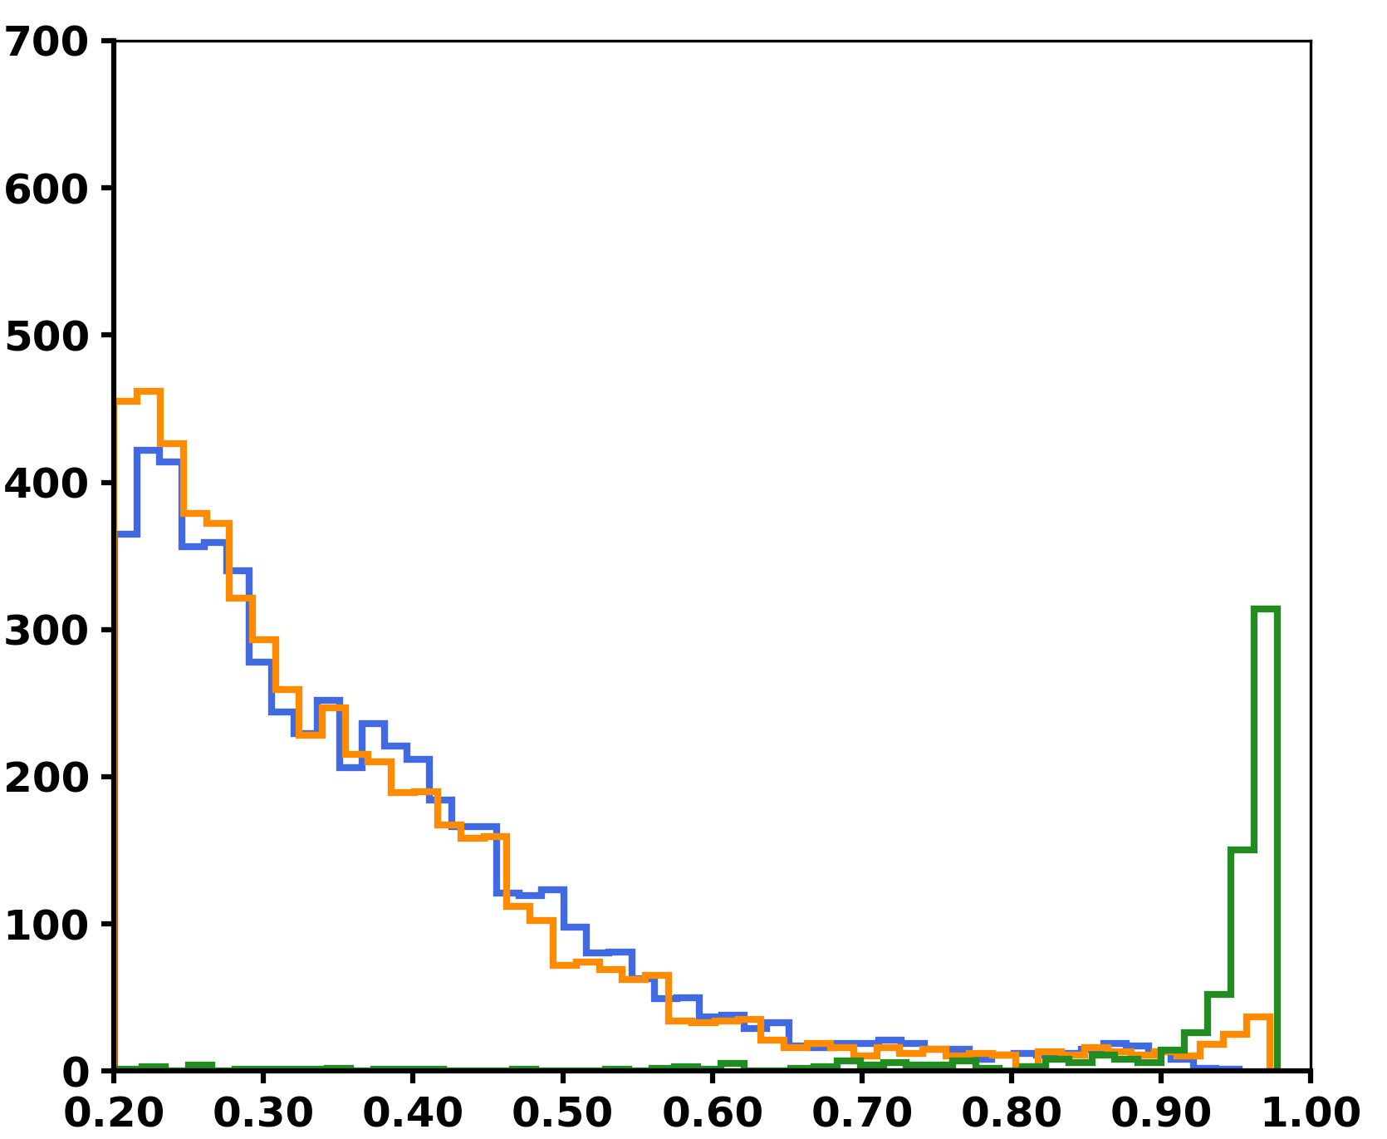
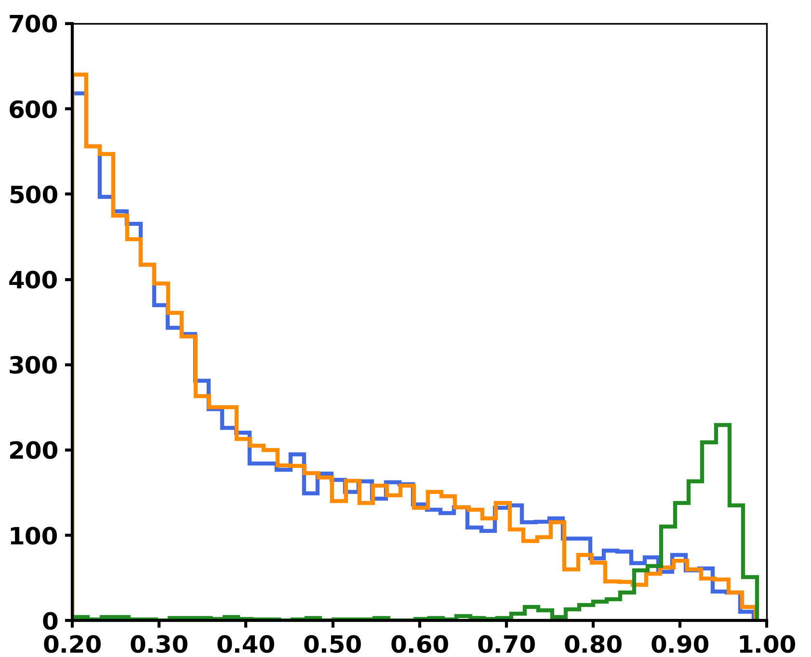
Res=30k,noise1e3
Res=70k,noise1e3
---- EstimatedFDR
True FDR
Qvalue or FDR
True Positives
Decoy Masses
False Positives
Count
Qscore

